Slide 1
probability Warm Up page 12- write the question you have 10 mins to complete it. See coaching on page 85

Slide 2
Permutations and Combinations
Mrs. Williams-Brissett
Copyright© 2013 EducAide Software Inc. All rights reserved.

Slide 3
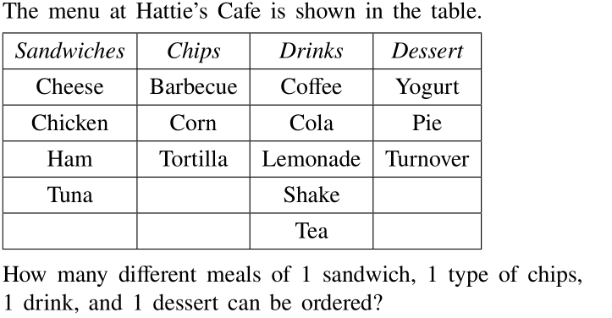
1
Copyright© 2013 EducAide Software Inc. All rights reserved.

Slide 4
2
Copyright© 2013 EducAide Software Inc. All rights reserved.

Slide 5
3
Copyright© 2013 EducAide Software Inc. All rights reserved.

Slide 6
4
Copyright© 2013 EducAide Software Inc. All rights reserved.

Slide 7
5
Copyright© 2013 EducAide Software Inc. All rights reserved.

Slide 8
6
Copyright© 2013 EducAide Software Inc. All rights reserved.

Slide 9
7
Copyright© 2013 EducAide Software Inc. All rights reserved.

Slide 10
8
Copyright© 2013 EducAide Software Inc. All rights reserved.

Slide 11
9
Copyright© 2013 EducAide Software Inc. All rights reserved.

Slide 12
10
Copyright© 2013 EducAide Software Inc. All rights reserved.

Slide 13
11
Copyright© 2013 EducAide Software Inc. All rights reserved.

Slide 14
12
Copyright© 2013 EducAide Software Inc. All rights reserved.

Slide 15
13
Copyright© 2013 EducAide Software Inc. All rights reserved.

Slide 16
14
Copyright© 2013 EducAide Software Inc. All rights reserved.

Slide 17
15
Copyright© 2013 EducAide Software Inc. All rights reserved.

Slide 18
16
Copyright© 2013 EducAide Software Inc. All rights reserved.

Slide 19
17
Copyright© 2013 EducAide Software Inc. All rights reserved.

Slide 20
A permutation is an arrangement of objects in a specific order.
Example:
The possible permutations of the letters
A, B, and C without repeating and letter is
ABC
ACB
BAC
BCA
CAB
CBAThere are 6 permutations (6 arrangements)

Slide 21
Permutations - Official Formula
To find the number of Permutations of n items
chosen r at a time, you can use the formula:

Slide 22
Permutations – order matters
A combination lock will open when the right
choice of three numbers (from 1 to 30, inclusive)
is selected. How many different lock combinations are
possible assuming no number is repeated?
Answer Now

Slide 23
Permutations – order matters
From a club of 24 members, a President, Vice President,
Secretary, Treasurer and Historian are to be elected.
In how many ways can the offices be filled?
Answer Now

Slide 24
18
Copyright© 2013 EducAide Software Inc. All rights reserved.

Slide 25
19
Copyright© 2013 EducAide Software Inc. All rights reserved.

Slide 26
20
Copyright© 2013 EducAide Software Inc. All rights reserved.

Slide 27
21
Copyright© 2013 EducAide Software Inc. All rights reserved.

Slide 28
22
Copyright© 2013 EducAide Software Inc. All rights reserved.

Slide 29
A combination consists of objects without regard to order.
Example:
Selecting two side dishes from a list of
5 dishes, the order in which you choose
the side dishes from the list does not matter.

Slide 30
Combinations – order doesn’t matter
To find the number of Combinations of n items
chosen r at a time, you can use the formula:
Notice, this is the permutation formula divided
by r! to cancel out the repetitions.

Slide 31
Combinations
Arnold, Beth, and Corrie, all work in the same department.
One person must work on the 4th of July.
How many different ways can the two people who get the day
off be chosen?
3 – Arnold and Beth, Arnold and Corrie, Beth and Corrie.

Slide 32
Combinations
How is this situation similar or different from the last?
Similar – choosing two of three people
Different – order did not matter, we were looking for a ‘group’
Combinations are arrangements of items where order does not matter.

Slide 33
Combinations – order doesn’t matter
To play a particular card game, each player is dealt five
cards from a standard deck of 52 cards.
How many different hands are possible?
Answer Now

Slide 34
23
Copyright© 2013 EducAide Software Inc. All rights reserved.

Slide 35
24
Copyright© 2013 EducAide Software Inc. All rights reserved.

Slide 36
25
Copyright© 2013 EducAide Software Inc. All rights reserved.

Slide 37
Practice …
How many ways can 8 of 15 students line up to walk to lunch?
How many ways can you choose 3 of 10 summer reading books?
How many ways can pick a three digit lock code if numbers cannot repeat?
How many ways can you pick 2 of 5 lamps for your new living room?

Slide 38
Practice …
How many ways can 8 of 15 students line up to walk to lunch?
Permutation; ₁₅P₈ = 259,459,200
How many ways can you choose 3 of 10 summer reading books?
Combination; ₁₀C₃ = 120

Slide 39
Practice …
How many ways can pick a three digit lock code if numbers cannot repeat?
Permutation; ₁₀P₃ = 720
How many ways can you pick 2 of 5 lamps for your new living room?
Combination; ₅C₂ = 10

Slide 40
Challenge …
A basketball team consists of two centers, five forwards, and four
guards. In how many ways can the coach select a starting line
up of one center, two forwards, and two guards?
Answer Now

Slide 41
Challenge …
A basketball team consists of two centers, five forwards, and four guards. In how many ways can the coach select a starting line up of one center, two forwards, and two guards?
Center:
Forwards:
Guards:
Thus, the number of ways to select the starting line up is 120.

Slide 42
Challenge …
A local restaurant is running a dinner date special.
For $24.99 you can choose 2 of 6 appetizers, 2 of 12 entrées,
and 2 of 4 desserts. Assuming you and your date do not order
the same items, how many ways could you create a
dinner date special?

Slide 43
Challenge …
A local restaurant is running a dinner date special. For $24.99
you can choose 2 of 6 appetizers, 2 of 12 entrées,
and 2 of 4 desserts. Assuming you and your date do not
order the same items, how many ways could you create a
dinner date special?
Entrées:
Desserts:
Appetizers:
Thus the number of possible meals is 5,940.

